Slide 1

Introduction to Selenium

Slide 2
Automated Testing
Nowadays, more and more business transactions are carried out on the Internet through web pages/applications built by people.
Some websites/applications are simple enough that they can be set up by one or two people, but some websites/applications are so complex that they are built by hundreds or even thousands of developers.
Before each release, the site/application must be tested to make sure it is free of critical bugs.
It is time-consuming to test the whole site manually, and as the site grows, so does the cost of testing.
More than that, as time passes, a new feature that was well-tested when it first became available may be forgotten about later— we risk of a loss of consistency and quality, and as a result bugs in what we thought were solid pieces of functionality creep in.

Slide 3
Automated Testing
In the textile industry, manual labor dominated the process of making clothes for a long time. When weaving machines were invented, productivity improved dramatically.
The same thing is happening in software testing. Just as weaving machines changed the textile industry, we are now building "automatic testing machines" to replace manual testing, to improve the productivity, quality, and consistency of the software.
Since its inception in 2008, Selenium WebDriver (also known as Selenium 2) has established itself as the de facto web automation library.

Slide 4
What is WebDriver?
Selenium WebDriver automates web browsers.
It sits in the place of the person using a web browser.
Like a user, it can open a website, click links, fill in forms, and navigate around.
It can also examine the page, looking at elements on it and making choices based on what is sees.

Slide 5
What is WebDriver used for?
The most common use case for WebDriver is automated testing.
Until recently, to run a regression test on your website, you’d need to have a set of scripts that would have to be manually executed by developers or QAs. Any reports would need to be manually collated too. This can be both time-consuming and costly.
Instead, WebDriver can be used to execute those scripts, and automatically gather reports on how successful they were, at the push of a button.
Each subsequent execution will be no more expensive than the first.
WebDriver can run tests on different operating systems and different browser configurations, and in a fraction of the time of a human being.
Not only that, you can use it to run them much more consistently and reliably than a manual tester.

Slide 6
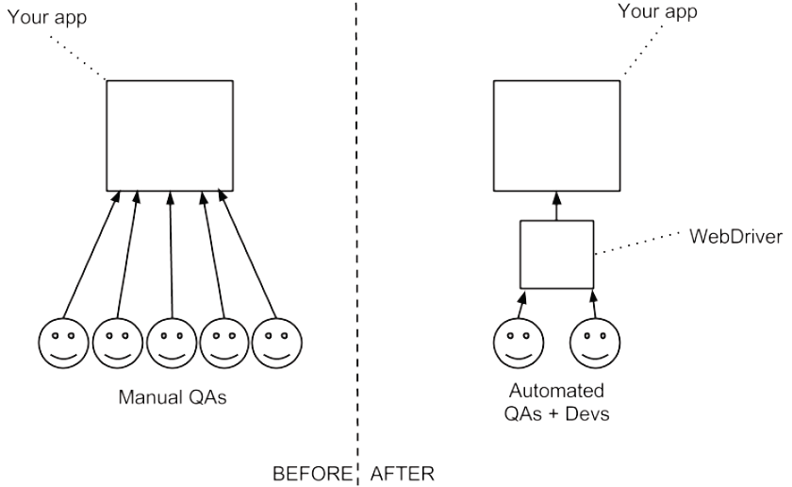
Before/After Webdriver

Slide 7
The history of Selenium
Selenium is a suite of web testing tools, including Selenium IDE, Selenium RC, Selenium WebDriver, and Selenium Grid.
The earliest Selenium is called Selenium Core, which came out in 2004 of ThoughtWorks’s Chicago office developed by Jason Huggins.
Later, Shinya Kasatani developed a Firefox plugin called Selenium IDE on top of Selenium Core. Selenium IDE is a graphic interface allowing users to record a browser navigation session, which can be replayed afterwards.
Later Selenium Core evolved into Selenium RC ("RC" meaning "Remote Control"), along with Selenium Grid, which allowed tests can be run on many machines at the same time.

Slide 8
The history of Selenium
In 2008, Selenium incorporated WebDriver API and formed Selenium 2.0.
In favor of this new simplified WebDriver API, Selenium RC has been deprecated and its usage is no longer encouraged.
Today, when people talk about "Selenium," they’re usually talking about Selenium WebDriver
Jason Huggins joked about a competitor named Mercury in an email, saying that you can cure mercury poisoning by taking selenium supplements. That’s where the name Selenium came from.

Slide 9
Why choose WebDriver?
WebDriver can run browsers locally and remotely with minimal configuration changes.
WebDriver is supported by major browser vendors: both Firefox and Chrome are active participants in WebDriver’s development.
WebDriver more closely mimics a user. Where possible it uses native events to operate, to make it accurate and stable
WebDriver is Open Source Software (OSS). This means that it is both free and is supported by an excellent community
WebDriver supports all major operating systems such as OS X, Windows, and Linux. It also has support for Android and iOS.
WebDriver has become a W3C standard, so you can expect that it will be supported for a long time.

Slide 10
What WebDriver cannot do
WebDriver doesn’t have the control of the timing of the elements appearing on the web page. Some might appear later and you’ll need to handle this yourself.
WebDriver does not know when things have changed on the page, so you can’t ask it to tell you when things have changed.
WebDriver doesn’t provide many utilities for writing your code. You need to write these yourself.
WebDriver doesn’t provide built-in support for page elements that are composed of multiple elements, such as JavaScript calendars
WebDriver does not provide a framework to write your code in.
WebDriver doesn’t manage the browser. For example, you need to clean up after you have used it.
We can use Selenium only to test web applications. We cannot test desktop applications or any other software.
WebDriver cannot handle captchas.
Don’t expect Selenium to work as you expect it to 100% of the time.

Slide 11
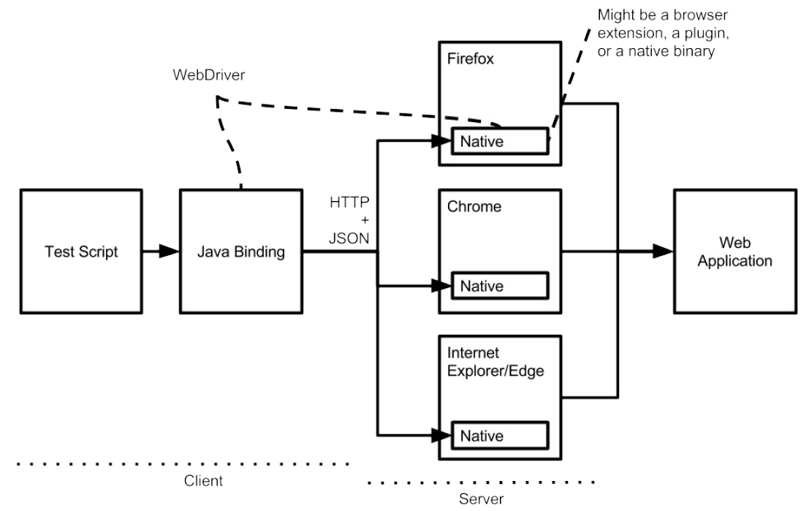
How WebDriver works
WebDriver works in all major browsers and with all major programming languages.
WebDriver has several interacting components:
1. A web browser.
2. A plugin or extension to the browser that lives inside the browser, which itself contains a server that implements the WebDriver JSON API.
3. A language binding (in our case Java) that makes HTTP requests to that API.

Slide 12
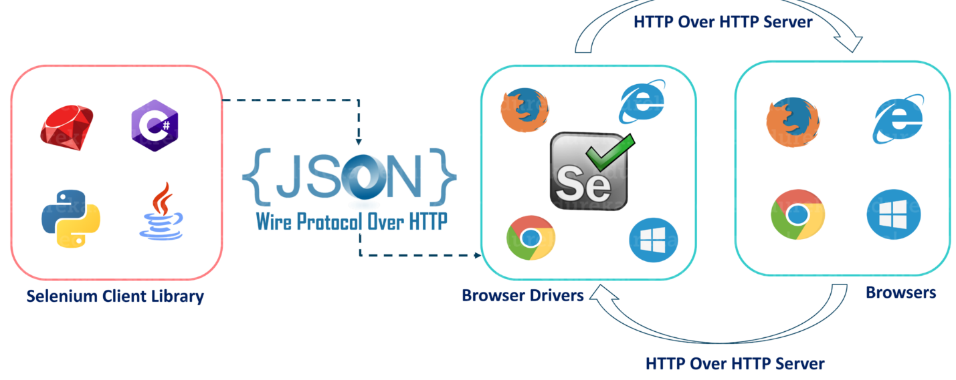
How WebDriver works
When you trigger the Test, complete Selenium code which we have written will be converted to Json format
Generated Json is sent to Browser Driver through http Protocol
Note: Each browser contains a separate browser driver
Browser drivers communicate with its corresponding browser and execute the commands by interpreting Json which it received on the browser.
Browser Driver receives responses back from the browser and it sends Json response back to Client.

Slide 13
Basic WebDriver Methods
get() - Load a new web page in the current browser window.
getCurentUrl() - Get a string representing the current URL that the browser is looking at.
getTitle() - The title of the current page
getPageSource() - Get the source of the last loaded page.
quit() - Quits this driver, closing every associated window.
close() - Close the current window, quitting the browser if it's the last window currently open.
navigate().to()
navigate().back()
navigate().forward()

